Slide 1
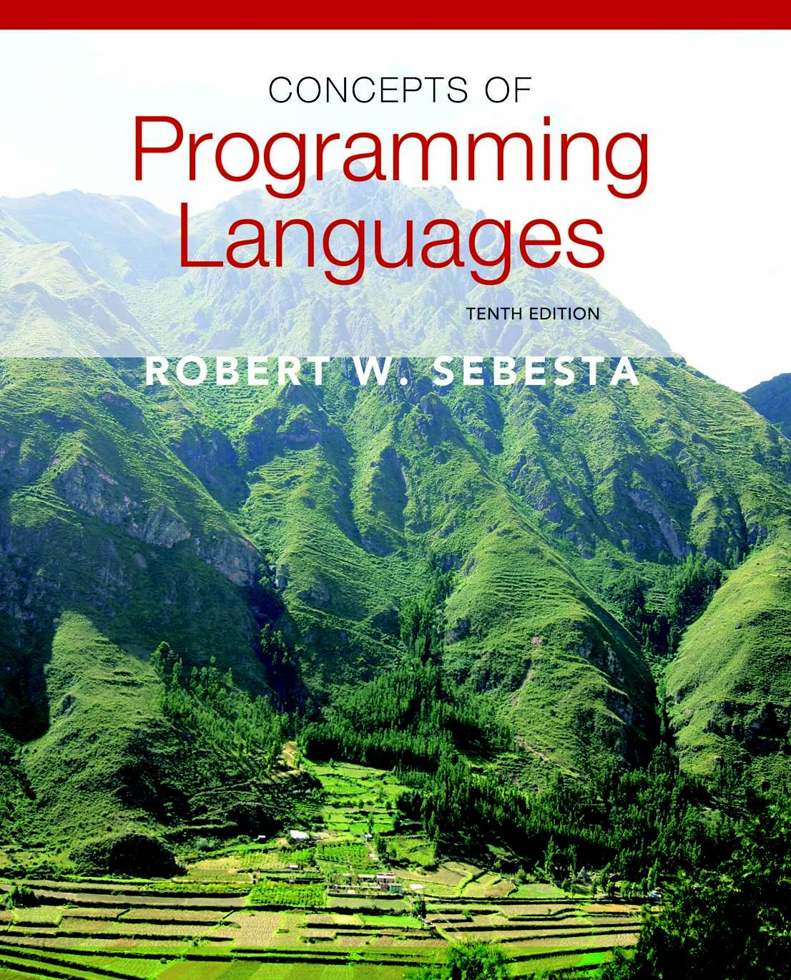
Copyright © 2012 Addison-Wesley. All rights reserved.

Slide 2
Lecture 4: Data Types
CS4080
(Chapter 6 )

Slide 3
Introduction
A data type defines a collection of data objects and a set of predefined operations on those objects
An object represents an instance of a user-defined (abstract data) type
One design issue for all data types: What operations are defined and how are they specified?

Slide 4
Primitive Data Types
Almost all programming languages provide a set of primitive data types
Primitive data types: Those not defined in terms of other data types
Some primitive data types are merely reflections of the hardware
Others require only a little non-hardware support for their implementation

Slide 5
Primitive Data Types: Integer
Almost always an exact reflection of the hardware so the mapping is trivial
There may be as many as eight different integer types in a language
Java’s signed integer sizes: byte, short, int, long

Slide 6
Primitive Data Types: Floating Point
Model real numbers, but only as approximations
Languages for scientific use support at least two floating-point types (e.g., float and double); sometimes more
Usually exactly like the hardware, but not always
IEEE Floating-Point
Standard 754

Slide 7
Primitive Data Types: Boolean
Simplest of all
Range of values: two elements, one for “true” and one for “false”
Could be implemented as bits, but often as bytes
Advantage: readability

Slide 8
Primitive Data Types: Character
Stored as numeric codings
Most commonly used coding: ASCII
An alternative, 16-bit coding: Unicode (UCS-2)
Includes characters from most natural languages
Originally used in Java
C# and JavaScript also support Unicode
32-bit Unicode (UCS-4)
Supported by Fortran, starting with 2003

Slide 9
Other Primitive Data Types
Complex
Some languages support a complex type, e.g., C99, Fortran, and Python
Each value consists of two floats, the real part and the imaginary part
Literal form (in Python): 7 + 3j
Decimal
For business applications (money)
COBOL, C#
Store a fixed number of decimal digits
Advantage: accuracy
Disadvantages: limited range, wastes memory

Slide 10
Character String Types
Values are sequences of characters
Design issues:
Is it a primitive type or just a special kind of array?
Should the length of strings be static or dynamic?
Why string type?
Add to writability
Typical operations:
Assignment and copying
Comparison (=, >, etc.)
Catenation
Substring reference
Pattern matching

Slide 11
Character String Type in Certain Languages
C and C++
Not primitive
Use char arrays and a library of functions that provide operations
SNOBOL4 (a string manipulation language)
Primitive
Many operations, including elaborate pattern matching
Fortran and Python
Primitive type with assignment and several operations
Java
Primitive via the String class
Perl, JavaScript, Ruby, and PHP, Python
- Provide built-in pattern matching, using regular
expressions (primitive vs. built-in?) https://en.wikipedia.org/wiki/Primitive_data_type -- answers on wiki may be challenged

Slide 12
Character String Length Options
Static: COBOL, Java’s String class
Limited Dynamic Length: C and C++
In these languages, a special character is used to indicate the end of a string’s characters, rather than maintaining the length
Dynamic (no maximum): SNOBOL4, Perl, JavaScript
Ada supports all three string length options
Notes:
12

Slide 13
User-Defined Ordinal Types
An ordinal type is one in which the range of possible values can be easily associated with the set of positive integers
Examples of primitive ordinal types in Java
integer
char
Boolean
User-defined ordinal types
Enumeration type
Subrange type

Slide 14
Enumeration Types
All possible values, which are named constants, are provided in the definition
C# example
enum days {mon, tue, wed, thu, fri, sat, sun};
Design issues
Is an enumeration constant allowed to appear in more than one type definition, and if so, how is the type of an occurrence of that constant checked?
Are enumeration values coerced to integer?
Any other type coerced to an enumeration type?

Slide 15
Evaluation of Enumerated Type
Aid to readability, e.g., no need to code a color as a number
Aid to reliability, e.g., compiler can check:
operations (don’t allow colors to be added)
No enumeration variable can be assigned a value outside its defined range
Ada, C#, and Java 5.0 provide better support for enumeration than C++ because enumeration type variables in these languages are not coerced into integer types

Slide 16
Subrange Types
An ordered contiguous subsequence of an ordinal type
Example: 12..18 is a subrange of integer type
Ada’s design
type Days is (mon, tue, wed, thu, fri, sat, sun);
subtype Weekdays is Days range mon..fri;
subtype Index is Integer range 1..100;
Evaluation
Aid to readability
Make it clear to the readers that variables of subrange can store only certain range of values
Reliability
Assigning a value to a subrange variable that is outside the specified range is detected as an error

Slide 17
Array Types
An array is an aggregate of homogeneous data elements in which an individual element is identified by its position in the aggregate, relative to the first element.
In some (newer) languages array could contain heterogeneous data
tuple (in Lua, Python, Ruby, …) or list (in Lisp, Prolog, Python …) also possess some features of array
Design Issues
What types are legal for subscripts?
Are subscripting expressions range checked?
When are subscript ranges bound?
When does allocation take place?
What is the maximum number of subscripts?
Can array objects be initialized?
Are any kind of slices supported?

Slide 18
Array Indexing
Indexing (or subscripting) is a mapping from indices to elements
array_name (index_value_list) → an element
Index Syntax
FORTRAN, PL/I, Ada use parentheses
Ada explicitly uses parentheses to show uniformity between array references and function calls because both are mappings
Most other languages use brackets
Indexing (or subscripting) is a mapping from indices to elements
array_name (index_value_list) → an element
Index Syntax
FORTRAN, PL/I, Ada use parentheses
Ada explicitly uses parentheses to show uniformity between array references and function calls because both are mappings
Most other languages use brackets

Slide 19
Arrays Index (Subscript) Types
FORTRAN, C: integer only
Ada: integer or enumeration (includes Boolean and char)
Java: integer types only
Index range checking
- C, C++, Perl, and Fortran do not specify
range checking
- Java, ML, C# specify range checking
- In Ada, the default is to require range
checking, but it can be turned off

Slide 20
Subscript Binding and Array Categories
Static: subscript ranges are statically bound and storage allocation is static (before run-time)
Advantage: efficiency (no dynamic allocation)
Example: C/C++ arrays with static modifier
static int data[3] = {2, 3, 4};
Fixed stack-dynamic: subscript ranges are statically bound, but the allocation is done at declaration time
Advantage: space efficiency
Example: C/C++ arrays without static modifier
int values[3] = {4, 5, 6};

Slide 21
Subscript Binding and Array Categories
Stack-dynamic: subscript ranges are dynamically bound and the storage allocation is dynamic (done at run-time)
Advantage: flexibility (the size of an array need not be known until the array is to be used)
Example: Ada
get (Len);
declare
List : array (1..Len) of Integer;
begin
…
end;
Question: Does C++support stack-dynamic arrays?

Slide 22
Subscript Binding and Array Categories
Fixed heap-dynamic: similar to fixed stack-dynamic: storage binding is dynamic but fixed after allocation (i.e., binding is done when requested and storage is allocated from heap, not stack)
C++ : using new/delete to allocate/deallocate from the heap
Java arrays: fixed heap dynamic arrays
C#: ArrayList
Heap-dynamic: binding of subscript ranges and storage allocation is dynamic and can change any number of times
Advantage: flexibility (arrays can grow or shrink during program execution)
Examples: Perl, JavaScript, Python, and Ruby
Perl: @states = (“Idaho”, “Oregon”, “Nevada”);
Python: values = [1.0, 20, “abc”]

Slide 23
Heterogeneous Arrays
Traditional arrays are homogeneous arrays
Elements of the same type
Some newer languages also support heterogeneous arrays
Elements need not be of the same type
Supported by Perl, Python, JavaScript, Ruby etc.

Slide 24
Array Initialization
C-based languages
int list [] = {1, 3, 5, 7}
char *names [] = {“Mike”, “Fred”,“Mary Lou”};
Ada
List : array (1..5) of Integer :=
(1 => 17, 3 => 34, others => 0);
Python
List comprehensions
list = [x ** 2 for x in range(12) if x % 3 == 0]
puts [0, 9, 36, 81] in list

Slide 25
Arrays Operations
APL provides the most powerful array processing operations for vectors and matrixes as well as unary operators (for example, to reverse column elements)
Ada allows array assignment but also catenation
Python’s array assignments, but they are only reference changes. Python also supports array catenation and element membership operations
Ruby also provides array catenation
Fortran provides elemental operations because they are between pairs of array elements
For example, + operator between two arrays results in an array of the sums of the element pairs of the two arrays

Slide 26
Array Implementation
Memory allocation for 1D (homogeneous) arrays
A block of contiguous memory, equal amount of space for each element
Address of array: starting memory location
Address of array elements: how to compute?
Pointer arithmetic in C/C++
Multi-dimensional arrays
Single block of contiguous memory for all elements
Arrays must be rectangular
Row majored (most languages) vs. column majored (FORTRAN)
Address of array[i][j]: how to compute (assume row-majored)?
Implement as arrays of arrays
Jagged arrays are possible
Array content may be pointer/reference

Slide 27
Multidimensional arrays in Java
Implemented as arrays of arrays
Support jagged arrays
Jagged arrays: rows with varying number of elements
Supported by C,C++, Java etc.

Slide 28
Compile-time Descriptors
Single-dimension arrays Multi-dimensional arrays
Array
Element type
Index type
Index lower bound
Index upper bound
Address
Mult-dim Array
Element type
Index type
No. of dimensions
Index range 1
…
Index range n
Address

Slide 29
Slices
A slice is some substructure of an array; nothing more than a referencing mechanism
Slices are only useful in languages that have array operations
Examples
Fortran 95
Integer, Dimension (10) :: Vector
Vector (3:6) is a four element array
Ruby supports slices with the slice method
list.slice(2, 2) returns the third and fourth elements of list

Slide 30
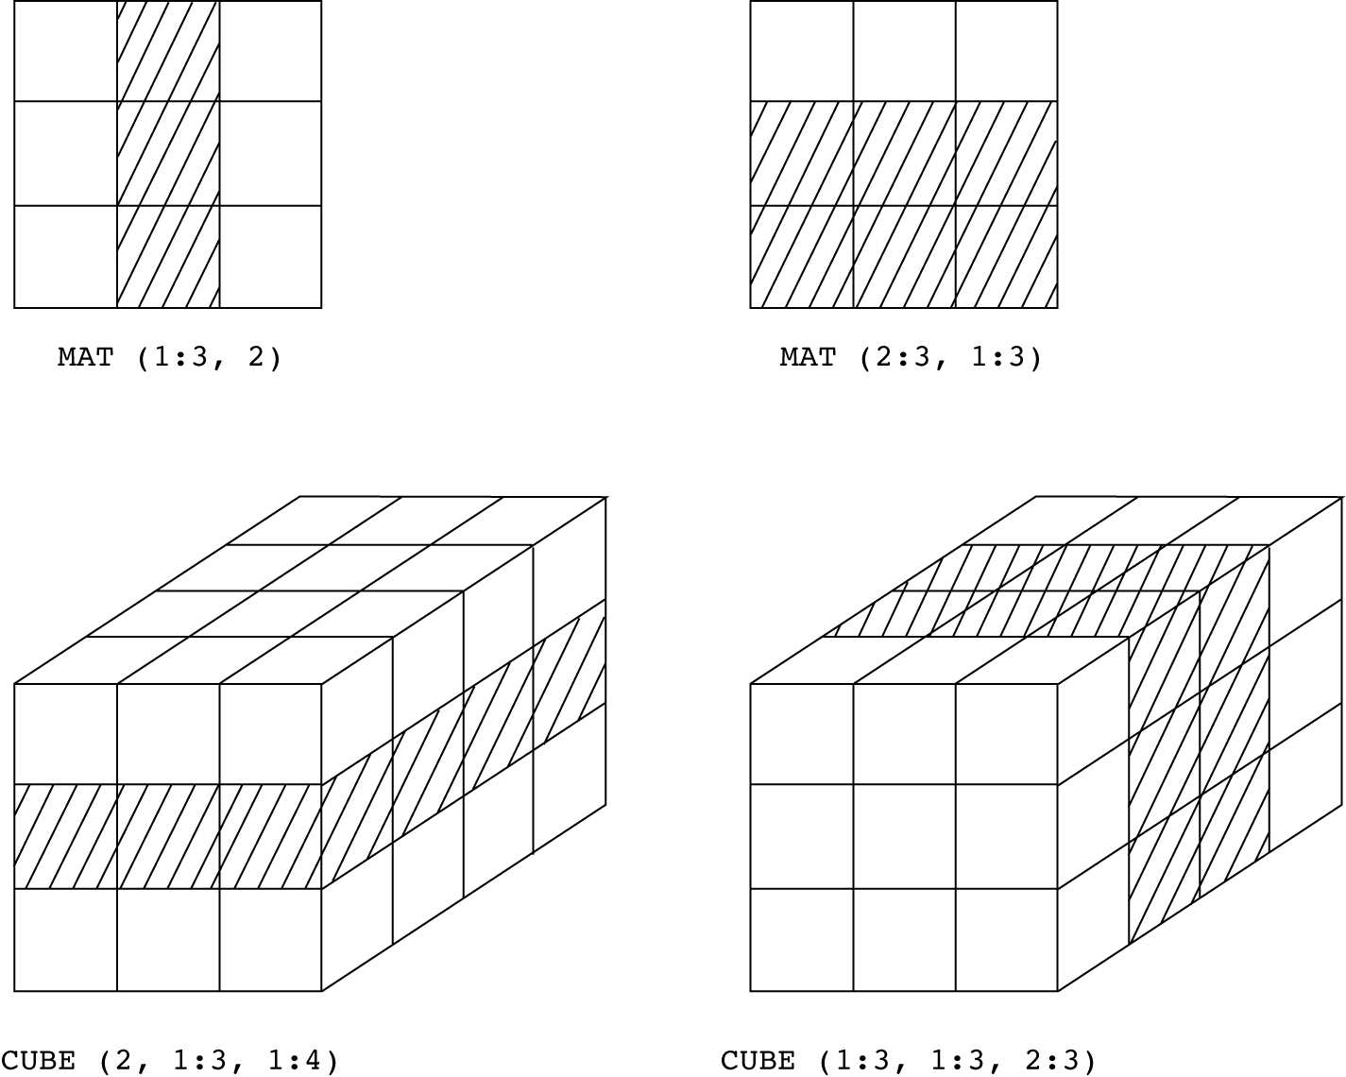
Slices Examples

Slide 31
Associative Arrays
An associative array is an unordered collection of data elements that are indexed by an equal number of values called keys
User-defined keys must be stored
Design issues:
- What is the form of references to elements?
- Is the size static or dynamic?
Built-in type in Perl, Python, Ruby, and Lua
In Lua, they are supported by tables

Slide 32
Associative Arrays in Perl
Names begin with %; literals are delimited by parentheses
%hi_temps = ("Mon" => 77, "Tue" => 79, “Wed” => 65, …);
Subscripting is done using braces and keys
$hi_temps{"Wed"} = 83;
Elements can be removed with delete
delete $hi_temps{"Tue"};

Slide 33
Other array-like types
Ruby has hashes
ht = { key1 => value1, …}
Use ht[key1] to access
Python has dictionary type
ht = {key1 : value1, …}
use ht[key1] to access
Vectors
Like arrays, with dynamic resizability, more flexible
Lists
Like vectors, but no direct accessing (ith element can only be accessed by counting down from the 1st element.)

Slide 34
Record Types
A record is a possibly heterogeneous aggregate of data elements in which the individual elements are identified by names
struct in C/C++
Design issues:
What is the syntactic form of references to the field?
Are elliptical references allowed
Limited operations on record type
Assignment, initialization, comparison
Arrays vs. Records
Traditionally, homogeneous data elements vs. heterogeneous data elements
Access via index vs. access via field name

Slide 35
Records in Ada
Record structures are indicated in an orthogonal way
type Emp_Rec_Type is record
First: String (1..20);
Mid: String (1..10);
Last: String (1..20);
Hourly_Rate: Float;
end record;
Emp_Rec: Emp_Rec_Type;

Slide 36
Unions Types
A union is a type whose variables are allowed to store different types of values at different times during execution
Advantage & disadvantages
Save space but unsafe (no type checking)
Example
C language
union value
{ int n;
double d;
char *s;
};

Slide 37
Pointer and Reference Types
A pointer type variable has a range of values that consists of memory addresses and a special value, nil
Provide the power of indirect addressing, address arithmetic, explicit dereferencing, address of, …
Provide a way to manage dynamic memory (i.e. heap)
Recursive data structures such as linked list
Design Issues
scope of and lifetime of a pointer variable?
Are pointers restricted as to the type of value to which they can point?
Are pointers used for dynamic storage management, indirect addressing, or both?
Should the language support pointer types, reference types, or both?

Slide 38
Pointer Operations
Two fundamental operations: assignment and dereferencing
Assignment is used to set a pointer variable’s value to some useful address
Dereferencing yields the value stored at the location represented by the pointer’s value
Dereferencing can be explicit or implicit
C++ uses an explicit operation via *
j = *ptr
sets j to the value located at ptr

Slide 39
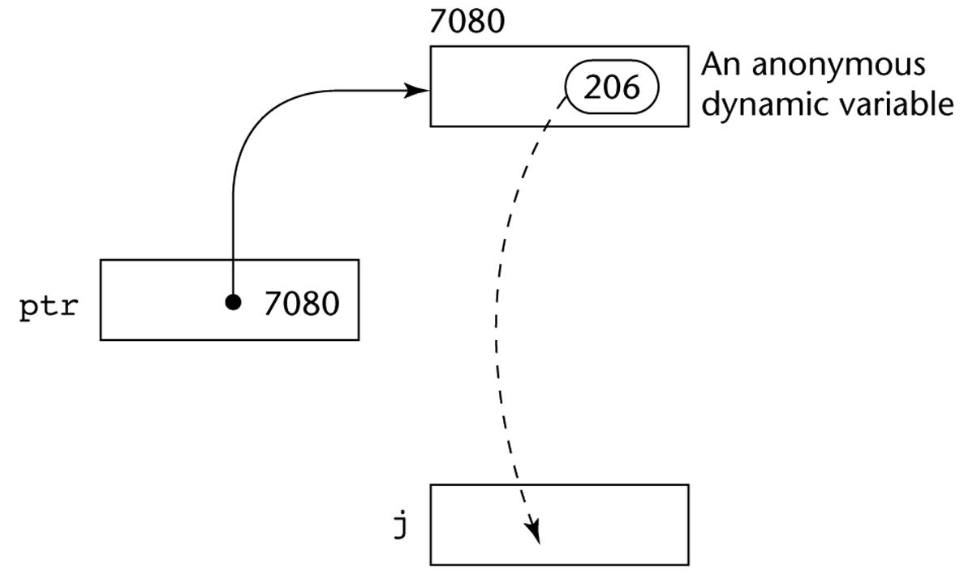
Pointer Assignment Illustrated
The assignment operation j = *ptr

Slide 40
Problems with Pointers
Dangling pointers (dangerous)
A pointer points to a heap-dynamic variable that has been deallocated
Lost heap-dynamic variable
An allocated heap-dynamic variable that is no longer accessible to the user program (often called garbage)
Pointer p1 is set to point to a newly created heap-dynamic variable
Pointer p1 is later set to point to another newly created heap-dynamic variable
The process of losing heap-dynamic variables is called memory leakage

Slide 41
Pointers in C and C++
Extremely flexible but must be used with care
Pointers can point at any variable regardless of when or where it was allocated
Used for dynamic storage management and addressing
Pointer arithmetic is possible
Explicit dereferencing and address-of operators
Example
float stuff[100];
float *p; p = stuff;
*(p+5) is equivalent to stuff[5] and p[5]
*(p+i) is equivalent to stuff[i] and p[i]

Slide 42
Problems with pointers: Example 1
Alias with side-effect
int *p1, *p2;
p1 = new int (2);
//same as p1 = new int; *p1=2;
p2 = new int (3);
p2 = p1;
*p2 = 4;
cout << *p1 << endl;
//readability?

Slide 43
Problems with pointers: Example 2
Dangling pointers
int *p1, *p2;
p1 = new int (2);
p2 = new int (3);
p2 = p1;
delete p1;
//what’s pointed by p2 now?

Slide 44
Problems with pointers: Example 3
Garbage (waste of memory)
int *p1, *p2;
p1 = new int [1000]; //allocate a large array
…
p1 = new int [10];
//what happens to the previously allocated 1000 //locations?

Slide 45
Problems with pointers: Example 4
Any problem with the following code?
int *p1, *p2;
*p1 = 2;
*p2 = 3;
cout << *p1 << *p2;
Any problem with the following code?
int *p1, *p2;
p1 = 2;
p2 = 3;
cout << p1 << p2 ;

Slide 46
Reference Types
C++ includes a special kind of pointer type called a reference type that is used primarily for formal parameters
Advantages of both pass-by-reference and pass-by-value
Java extends C++’s reference variables and allows them to replace pointers entirely
References are references to objects, rather than being addresses
C# includes both the references of Java and the pointers of C++

Slide 47
Evaluation of Pointers
Dangling pointers and dangling objects are problems as is heap management
Pointers are like goto's--they widen the range of cells that can be accessed by a variable
Pointers or references are necessary for dynamic data structures--so we can't design a language without them

Slide 48
Function types (optional)
Function type in C
typedef int (*IntFun) (int);
int square (int x) {return x*x;}
IntFun f = square
int evaluate (IntFun g, int v) {
return g(v);
}
printf(“%d\n”, evaluate (f, 3));

Slide 49
Function Type in ML
type IntFun = int -> int;
fun square(x : int) = x*x;
val f = square;
Fun evaluate (g:IntFun, v:int) = g v;
evaluate (f, 3);

Slide 50
Type Checking
Type checking is the activity of ensuring that the operands of an operator are of compatible types
A compatible type is one that is either legal for the operator, or is allowed under language rules to be implicitly converted, by compiler
This automatic conversion is called a coercion.
A type error is the application of an operator to an operand of an inappropriate type
If all type bindings are static, nearly all type checking can be static
If type bindings are dynamic, type checking must be dynamic

Slide 51
Type checking system
A program checks if data types are used correctly
The following strategies may be used in type checking system
Type inference: infer the type of an expression, whose data type is not given explicitly
E.g. In a function call: my_fun ( total / unit);
//If total is double, unit is integer, what is the type of this actual parameter?
Type equivalence: compare two data types, decide if they are the same
E.g. Assume an operator op can only operate on two values of the same type
if (a op b) … //check if any possible type error

Slide 52
Type compatibility: can we use a value of type A in a place that expects type B?
E.g. int estimate; double cost;
if (estimate > cost ) …
Note: type checking is nontrivial with user-defined types, anonymous types, typeless languages, …

Slide 53
Strong Typing
A programming language is strongly typed if type errors are always detected
Advantage of strong typing: allows the detection of the misuses of variables that result in type errors (reliability)
Language examples:
FORTRAN 95 is not: parameters, EQUIVALENCE
C and C++ are not: parameter type checking can be avoided; unions are not type checked
Ada is, almost (UNCHECKED CONVERSION is loophole)
In general, sample of strongly-typed: Ada, Haskell, Java, Pascal, ML, C#, … (though loop-hole may exist)

Slide 54
Weakly-typed and typeless languages
Weakly typed: C/C++
E.g. interoperablity of integers, pointers, arrays
int val, a[10], *p;
p = a;
val = *(p++);
Untyped (dynamically typed) languages
Examples: scheme, smalltalk, perl, …
All type checking performed at execution time
May produce run-time errors too frequently
Python is untyped language but with strong typing

Slide 55
Type Equivalence
Name type equivalence: two variables have equivalent types if they are in either the same declaration or in declarations that use the same type name
Easy to implement but highly restrictive:
Subranges of integer types are not equivalent with integer types
Formal parameters must be the same type as their corresponding actual parameters
Structure type equivalence means that two variables have equivalent types if their types have identical structures
More flexible, but harder to implement

Slide 56
Type Equivalence: Questions
Consider the problem of two structured types:
Are two record types equivalent if they are structurally the same but use different field names?
Are two array types equivalent if they are the same except that the subscripts are different?
(e.g. [1..10] and [0..9])
Are two enumeration types equivalent if their components are spelled differently?
With structural type equivalence, you cannot differentiate between types of the same structure (e.g. different units of speed, both float)

Slide 57
Type equivalence: case analysis
In Java/C++
class A { char x; int y; … };
class B { char a; int b; … };
Are these two classes of equivalent type?
Can we assign an object of B to an object of A?
A a = new B();

Slide 58
Type equivalence in Java
class/interface: name equivalence
Every new class/interface considered as a new type
arrays: structural equivalence

Slide 59
Type conversion in Java
Implicit conversion
Representation change
Type promotion, e.g. int to double
No representation change
Upcasting (see next slide)
Explicit conversion
Representation change
E.g. cast a double type data to an integer
double x = 2.5; int y = (int) x;
No representation change
Downcasting (see next slide)

Slide 60
Casting in Java
class A { … }
Class SubA extends A { … }
A a1 = new A ();
A a2 = new A();
SubA sa = new SubA();
a = sa; OK (upcasting)
sa = (SubA) a1; OK (downcasting)
sa = a2; compilation error

Slide 61
Summary
The data types of a language are a large part of what determines that language’s style and usefulness
The primitive data types of most imperative languages include numeric, character, and Boolean types
The user-defined enumeration and subrange types are convenient and add to the readability and reliability of programs
Arrays and records are included in most languages
Pointers are used for addressing flexibility and to control dynamic storage management

